Slide 1
COLLEGE PROJECT SUBMISSION
AI Job Market Analysis
A data analysis project to explore AI job trends, salaries, skills, and demand using Python and interactive visualizations.
BY:- ADITIYA | RBIENT HSP | 2449369 | CSE AI & ML
AI JOB MARKET ANALYSIS
01

Slide 2
02 — OVERVIEW
Table of Content
This presentation walks through the motivation, dataset, design, and outcomes of the Digital Detox Analyzer project — from identifying signs of digital overuse to outlining future enhancements.
1
Company's Profile
4
Dataset Overview
7
Planned Visualization
2
Problem Statement
5
Data Preprocessing
8
Challenges faced
3
Project Overview
6
Technologies and Tools used
9
Key Findings
10
Conclusion
AI JOB MARKET ANALYSIS
02

Slide 3
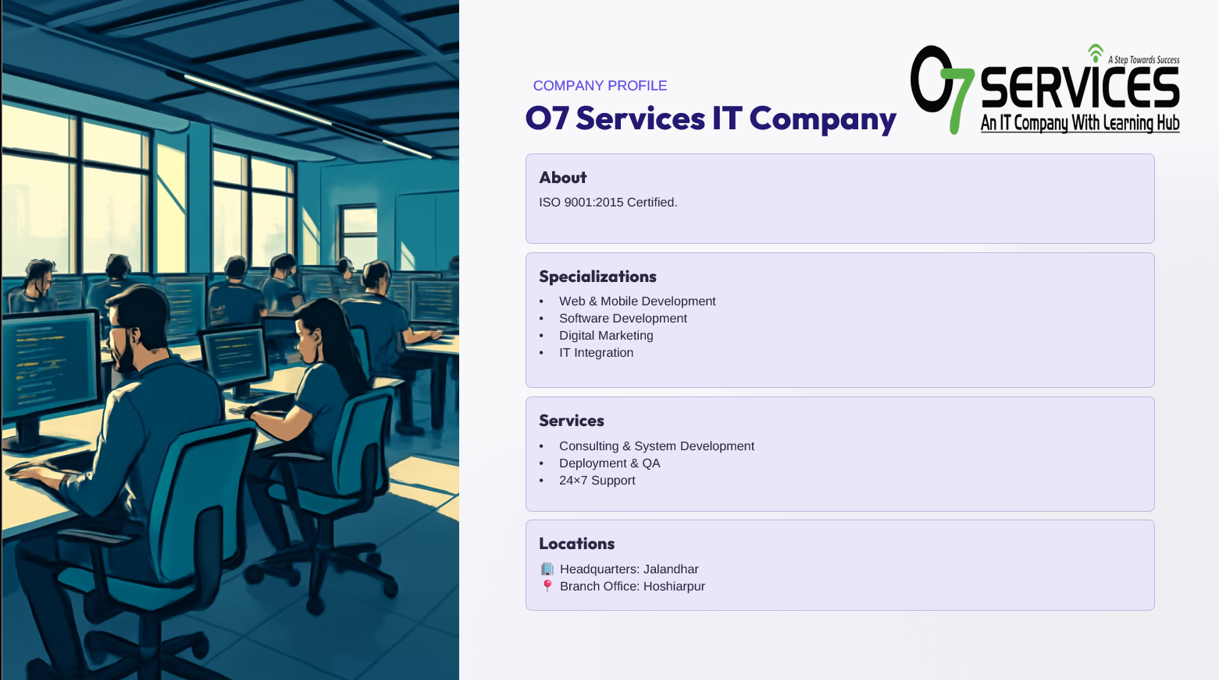
AI JOB MARKET ANALYSIS
03

Slide 4
04 — THE CHALLENGE
Problem Statement
1
2
AI job market data is large and complex, making it difficult to understand important trends and patterns.
Job seekers often struggle to identify the most in-demand skills and the qualifications required by employers.
3
4
Salary and job opportunities vary across different roles, companies, and locations, making career planning confusing.
Without proper data analysis and visualization, it is difficult to make informed career and hiring decisions.
AI JOB MARKET ANALYSIS
04

Slide 5
05 — PROJECT OVERVIEW
AI Job Market Analysis
Artificial intelligence has become one of the fastest-growing fields in today’s technology industry. Every year, thousands of companies hire professionals for AI-related roles such as Machine Learning Engineer, Data Scientist, and AI Engineer.
This project focuses on analyzing an AI job market dataset to understand hiring trends, salary distribution, experience requirements, and the demand for different job roles. The analysis was carried out using Python and various data visualization libraries to convert raw data into meaningful insights.
AI JOB MARKET ANALYSIS
05

Slide 6
06 — GOALS
Project Objectives
1
2
3
4
5
Analyze AI job market trends
Study salary distribution
Compare experience levels
Analyse country-wise hiring
Find in-demand skills
Detect growth areas by role, industry, and time period to highlight demand trajectories.
Examine medians, quartiles, and outliers by role, country, and experience to reveal pay structure.
Map how junior-, mid-, and senior-level demand differs across roles and geographies.
Identify leading countries, regional concentrations, and remote hiring patterns.
Rank technical and soft skills appearing in postings to prioritise learning and hiring focus.
AI JOB MARKET ANALYSIS
06

Slide 7
07 — THE DATA
Dataset Overview
The dataset used in this project contains information related to AI jobs from different companies around the world. It includes details such as:
Company Location
Experience level
Remote work ratio
Required skills
Salary
Employement type
Company size
This dataset provides a clear picture of the current AI job market and helps in understanding industry trends.
AI JOB MARKET ANALYSIS
07

Slide 8
08 — PIPELINE
Data Preprocessing
Preprocessing ensures analytical validity and reproducibility. The pipeline followed these standard steps to prepare the dataset for analysis and modelling.
1
2
3
4
5
Explored the dataset
Removed duplicates
Checked data types & conversions
Handled missing values
Cleaned inconsistent data
›
Deduplicated by job title + company + posted date to avoid repeated listings skewing counts.
›
Converted salary ranges to numeric fields (min, max, median), parsed dates, and normalized location strings.
›
Imputed or flagged missing salaries, locations, and experience fields. Kept a “missing” category for categorical analysis when appropriate.
›
Normalized skills and titles (e.g., “ML Engineer” vs. “Machine Learning Engineer”), standardized country names, and tokenized skills lists for aggregation.
AI JOB MARKET ANALYSIS
08

Slide 9
09 — STACK
Technologies & Tools Used
We used a modern Python data science stack to load, clean, analyze, and visualize the AI job dataset.
1
2
3
4
Python
Jupyter Notebook
Numpy
Pandas
Primary language for data processing, scripting, and automation
Reproducible analysis, annotated code, and iterative visual exploration.
Numerical operations and efficient array processing
DataFrame operations: cleaning, merges, group-bys, and aggregation.
5
6
7
8
Matplotlib
Seaborn
Plotly
Streamlit
Exploratory plots: histograms, box plots, and distribution plots for statistical insight
Used for statistical graphing.
Used for interactive charts and maps
Builds interactive Python web apps without frontend code.
AI JOB MARKET ANALYSIS
09

Slide 10
10 — CHARTS
Planned Visualisations
This project uses different types of charts to better understand the AI job market. These charts make it easier to compare different aspects of the dataset and identify hidden trends.
1
2
3
4
5
Country-wise AI Jobs (Choropleth)
Top 10 AI Job Roles (Bar Chart)
Salary Distribution (Histogram / Box Plot)
Top Skills
Experience Level Distribution
Where are jobs concentrated? Reveal geographic hotspots and remote hiring patterns.
Which specific roles attract the most listings—useful for targeting training and hiring.
Understand central tendency and dispersion; identify high-paying roles and salary outliers.
Rank technical skills and certifications mentioned most often in listings.
Proportion of junior vs senior roles—informs hiring pipelines and training needs.
AI JOB MARKET ANALYSIS
10

Slide 11
11 — ROADBLOCKS
Challenges Faced
Missing values
Data cleaning complexity
Handling scale
Salary and location were often incomplete, requiring careful imputations and filtering to avoid bias.
Inconsistent job titles and skill spellings required normalization and mapping rules to aggregate correctly.
Large row counts required memory-efficient processing and occasional sampling for exploratory plots.
Selecting the most suitable charts for clear and meaningful data representation.
Presenting the findings in a simple and meaningful way
Understanding relationships between different variables.
AI JOB MARKET ANALYSIS
11

Slide 12
12 — RESULTS
Key findings:
The analysis revealed several interesting findings:
AI-related jobs are growing rapidly across the world.
1
Higher experience generally leads to higher salaries.
2
Some countries have a much greater demand for AI professionals.
3
Remote work opportunities have increased significantly.
4
Different job roles have different salary ranges and hiring patterns.
5
AI JOB MARKET ANALYSIS
12

Slide 13
13 — WRAP UP
13 — WRAP UP
Conclusion
Conclusion
The AI job market is large and dynamic. Our analysis highlights where demand is strongest, which roles and skills are most valuable, and how pay scales with experience. These insights inform three actionable recommendations:
1
Successfully analyzed the AI job market dataset using Python.
2
Cleaned and processed the data for accurate analysis.
3
Identified important trends in job roles, salaries, and experience levels.
4
Used different visualizations to present the data in a simple and clear way.
5
The project provides useful insights that can help students, job seekers, and recruiters understand the AI job market better.
AI JOB MARKET ANALYSIS
13

Slide 14
14 — WHAT'S NEXT
Future Plans
1
2
3
Add real-time job data so the dashboard always shows the latest AI job market trends and opportunities.
Introduce career recommendations that suggest suitable AI job roles and skills based on a user's profile.
Use AI to predict future trends, such as in-demand skills, salary growth, and hiring patterns.
4
5
Improve the dashboard interface by adding more interactive charts, filters, and downloadable reports.
Make the dashboard available online so users can access it anytime from any device.
AI JOB MARKET ANALYSIS
14

Slide 15
THANKYOU
AI JOB MARKET ANALYTIC DASHBOARD
FEEDBACK AND QUESTIONS ARE WELCOME
AI JOB MARKET ANALYSIS
15

